Slide 1
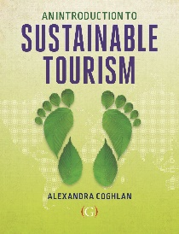

Revision: sustainable tourism
Lecture 10
© Alexandra Coghlan 2019 Introduction to Sustainable Tourism

Slide 2

Three pillars?
Make optimal use of environmental resources that constitute a key element in tourism development, maintain essential ecological processes and help to conserve natural heritage and beauty
Respect the socio-cultural authenticity of host communities, conserve their built and living cultural heritage and traditional values and contribute to their inter-cultural understanding and tolerance.
Ensure viable, long-term economic operations, providing socio-economic benefits to all stakeholders that are fairly distributed, including stable employment, and income earning opportunities and social services to host communities and contributing to poverty alleviation.
© Alexandra Coghlan 2019 Introduction to Sustainable Tourism

Slide 3
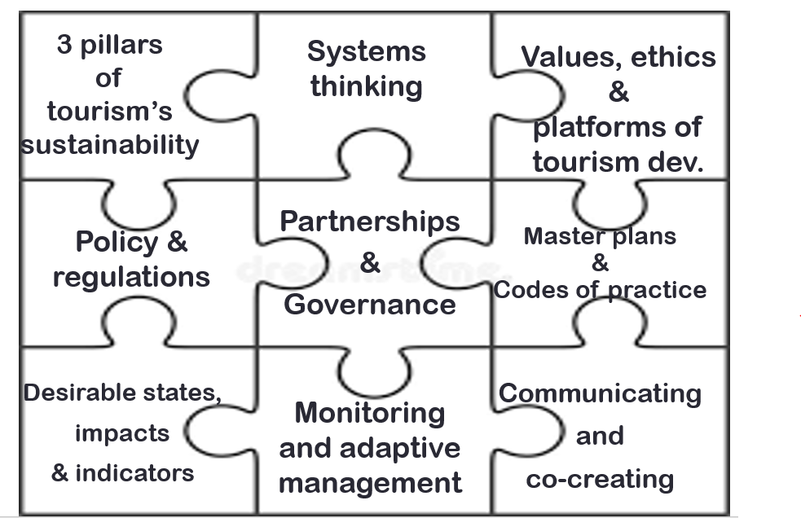
© Alexandra Coghlan 2019 Introduction to Sustainable Tourism

Slide 4
Decide on your desirable state
Be
Be aware of tourism impacts
Consider
Consider regulations, master plans, codes of practice and destination-level of decisions
Decide
Decide what has value to you, what those values are and how they are represented
Explore
Explore how they can be measured
Establish
Establish baseline and systematic monitoring
Start
Start managing adaptively
© Alexandra Coghlan 2019 Introduction to Sustainable Tourism

Slide 5
Manage adaptively
Consider
Consider your whole supply chain
Be
Be aware of your stakeholders
Keep
Keep adjusting your course of action
Seek
Seek feedback
Keep
Keep records
© Alexandra Coghlan 2019 Introduction to Sustainable Tourism

Slide 6
So what does this mean in practice?
Low
Low carbon emissions
Reduce
Reduce, reuse, recycle
Be
Be sensitive to context in building and landscaping (materials, footprint, water use, solar heating, beneficial plants)
Be
Be aware of other forms of pollution (noise, visual)
Maximise
Maximise benefit sharing and minimise leakage
Make
Make time for engagement with local issues
Create
Create local opportunities (capacity building)
Protect
Actively protect heritage
Foster
Foster inter-cultural understanding
© Alexandra Coghlan 2019 Introduction to Sustainable Tourism

Slide 7
SOME TOURISM TRENDS….
Customised
& flexible
Online & mobile
Social
& local
Connected & value-based
© Alexandra Coghlan 2019 Introduction to Sustainable Tourism

Slide 8

Key points:
Getting to sustainability is a process and a balancing act; it takes practice, skill and effort
Much of tourism is about selling and delivering dreams; sustainability needs to be built into the value proposition.
The scale and variety in tourism is limited only by your imagination: from special interest/niche market tours, to destination management of a whole region or country to space tourism and virtual tourism
Sustainability is a “value-driven journey, influenced primarily by the development of environmental consciousness and personal, socio-cultural and situational factors of the individual business-owners” (Garay & Font, 2015, p. 336).
© Alexandra Coghlan 2019 Introduction to Sustainable Tourism

